Slide 1

Text Correction
Supervisiors
Dr / Esraa Afify
Eng / Mostafa Gamal
Abd Elnaser Ahmed 205094
Samaa Sobhy 215009
Basmala Yasser 205045

Slide 2

Contents
Part 1
INTODUCTION
Part 2
Methodology
Part 3
CODE
Part 4
RESULT

Slide 3
INTRODCUTION
A software program or program feature designed to locate misspelled words and notify the user of the misspellings. Depending on the spell checker, the feature may autocorrect the word or allow users to select from potential corrections on the misspelled word.
A spell checker is an application, program or a function of a program which determines the correctness of the spelling of a given word based on the language set being used. It can either be a standalone program or part of a larger program which operates on blocks of text such as a word processor, search engine or an email client.
The spell checker compares every word typed with thousands of correctly spelled words and then uses algorithms to determine the correct spellings. If a word (e.g., a name) is spelled correctly, you can add it to the program's exceptions list, so it's not flagged as misspelled.

Slide 4
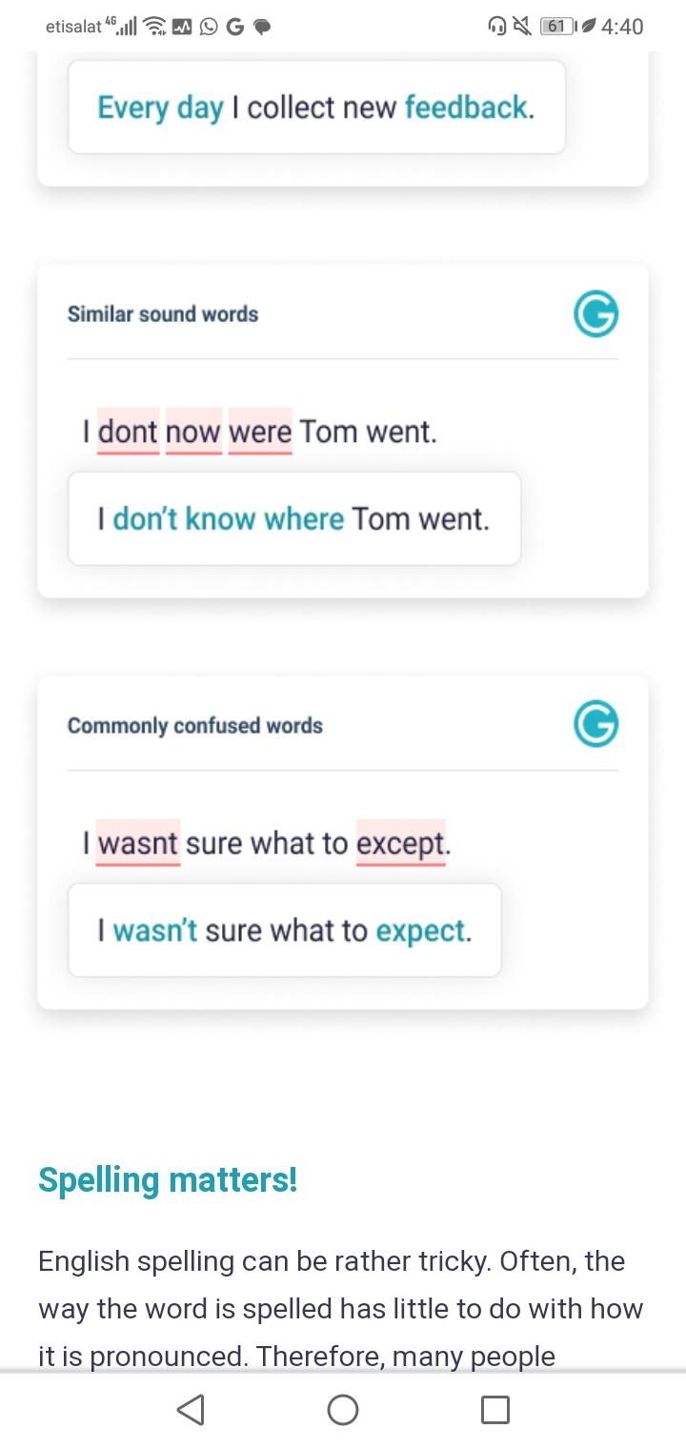
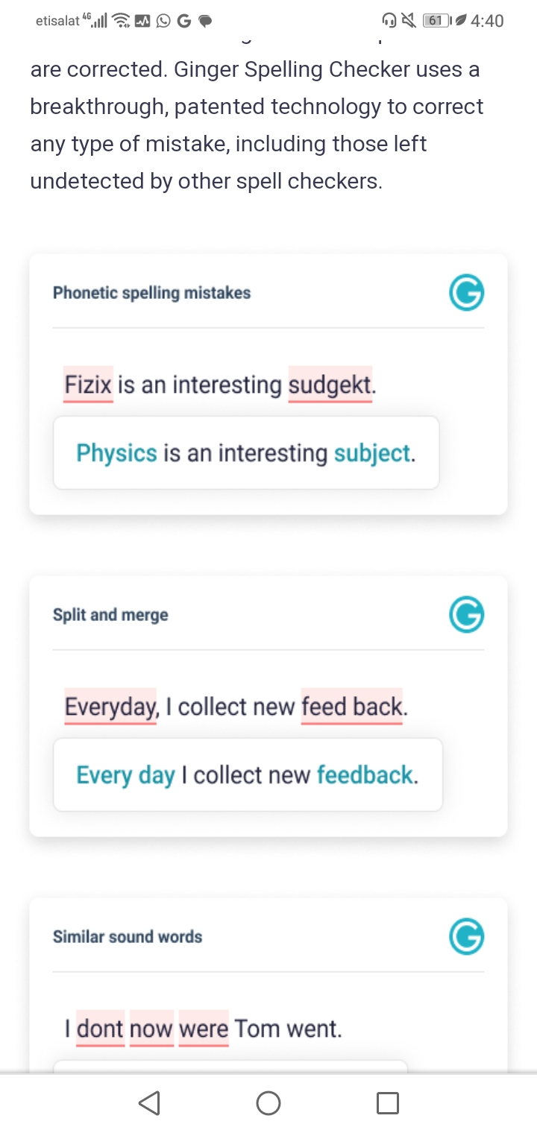
How Spell Checker Work?
The spell checker compares every word typed with thousands of correctly spelled words and then uses algorithms to determine the correct spellings. If a word (e.g., a name) is spelled correctly, you can add it to the program's exceptions list, so it's not flagged as misspelled.

Slide 5
Spell Checking Process
Scan blocks of text and extract individual words .
Compare each extracted word to known words contained in a dictionary file of correctly spelled words , which may also contain punctuation and grammatical rules .
Morphologic algorithms might also be applied for handling alternative forms of words used in different grammatical scenarios .
Mark the words with incorrect spelling and offer the correct spelling to the user . Some spell checkers change the incorrect words automatically if the setting is activated .

Slide 6
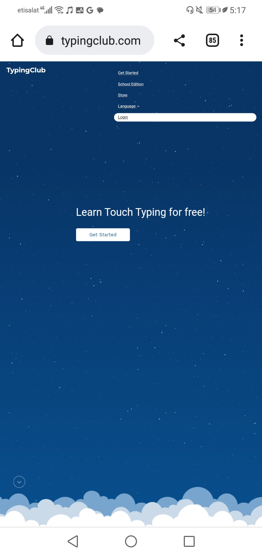
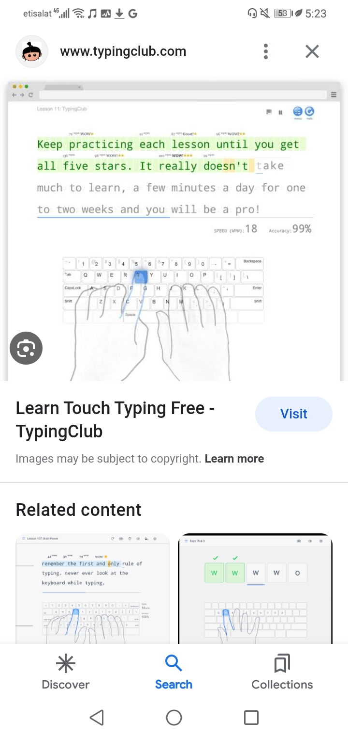
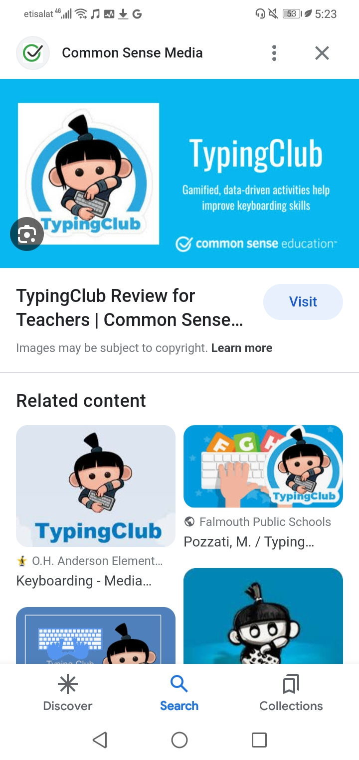
APPLICATIONS
TypingClub is the most accessible typing program available. Interactive experience. A full range of experiences from games, videos and different typing challenges makes learning fun. Voice over. Once you turn it on, every word is read out loud as you are typing each word.
Do you want to try? Here's the link.
https://www.typingclub.com/

Slide 7
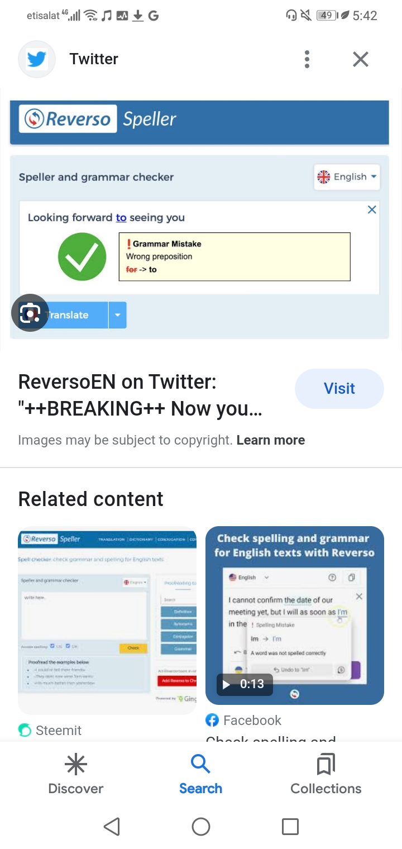
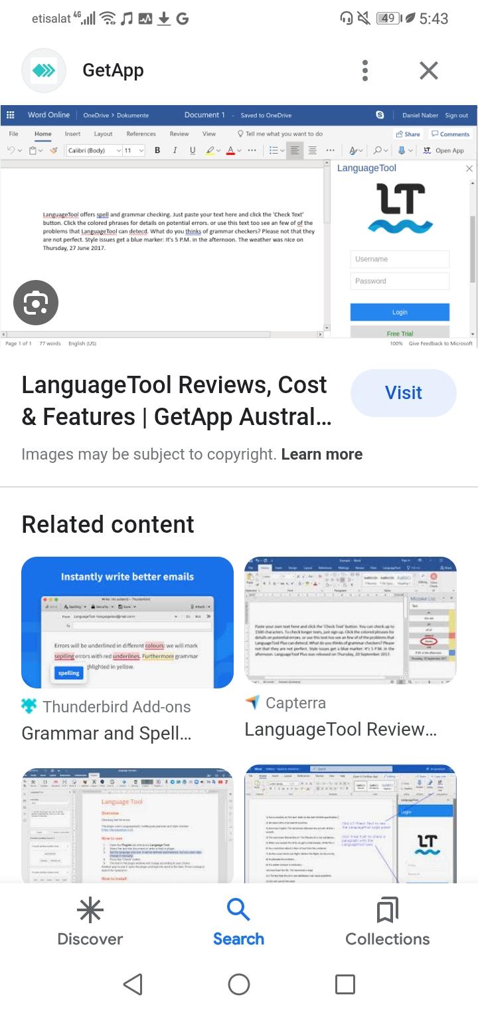
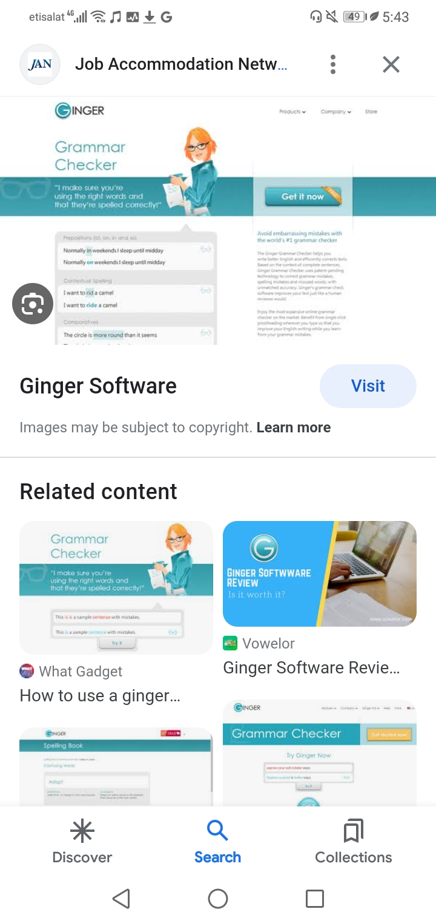
APPLICATIONS CONT..
There are many Applications, here some of them
Reverso
Language tool
Ginger Software
Corrector. Co
https://www.reverso.net/spell-checker/english-spelling-grammar/
https://languagetool.org/
https://www.gingersoftwa
https://www.corrector.co/

Slide 8
Used Libraries
Gingerit
1
Correcting spelling and grammar mistakes based on the context of complete sentences.
Gingerit
Streamlit
2
Streamlit lets you turn data scripts into shareable web apps in minutes
Tkinter
Text
Textblob
3
Textblob
library for processing textual data.
Tkinter
4
Streamlit
Tkinter is the standard GUI library for Python. Python when combined with Tkinter provides a fast and easy way to create GUI applications.

Slide 9
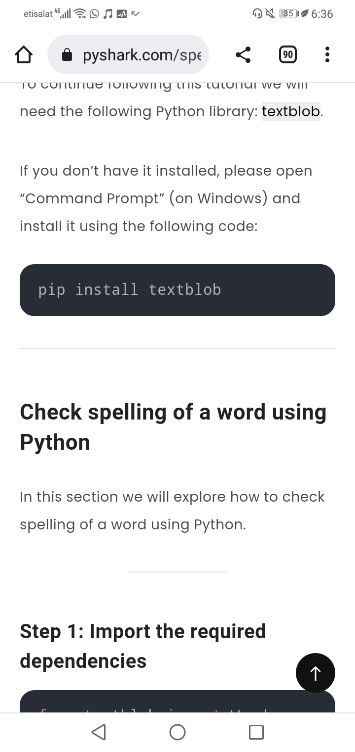
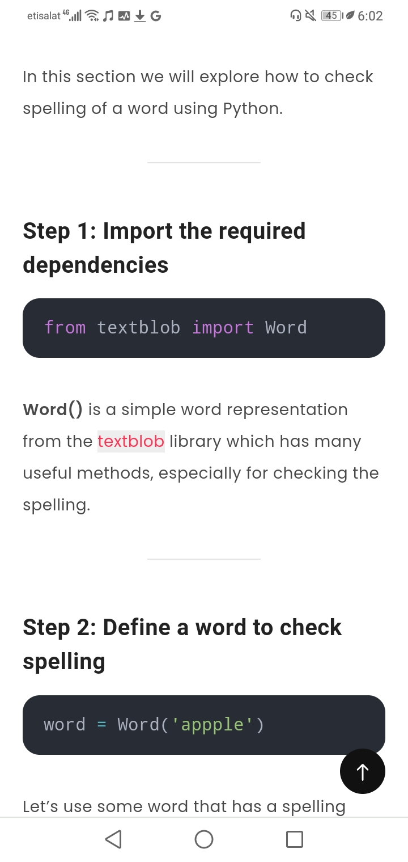
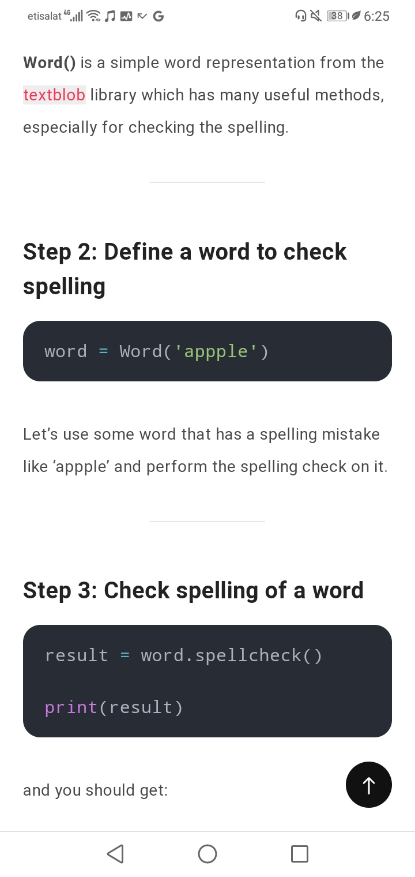
Check spelling of a word using Python
Check spelling of a word using Python
Define a word to check spelling

Slide 10
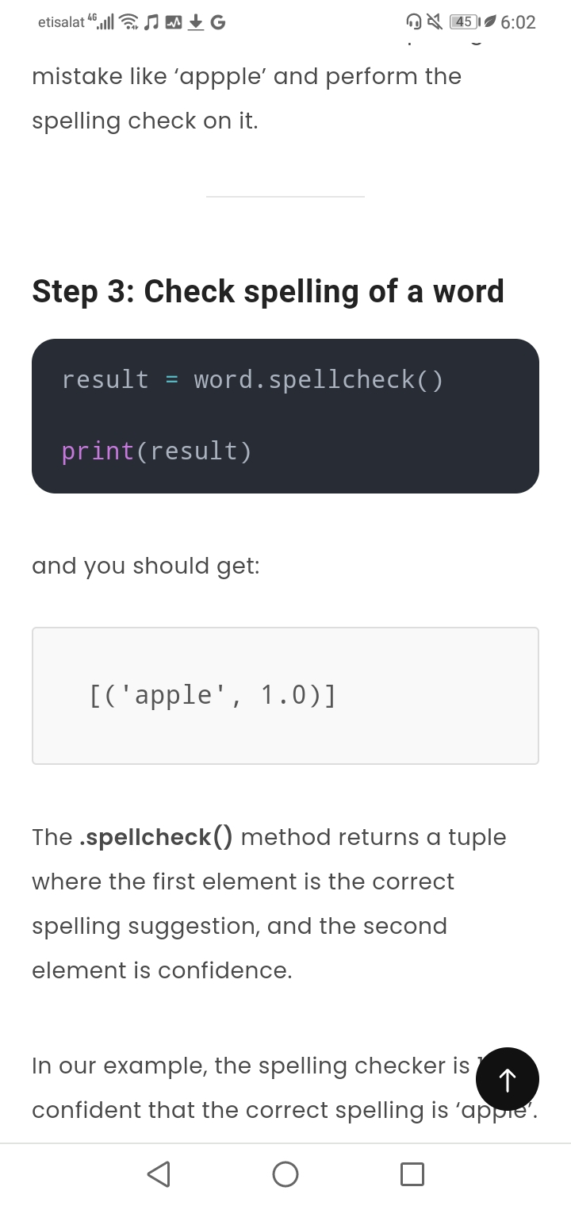
CONT..
Check spelling of a word
Program to check spelling of a word using Python

Slide 11
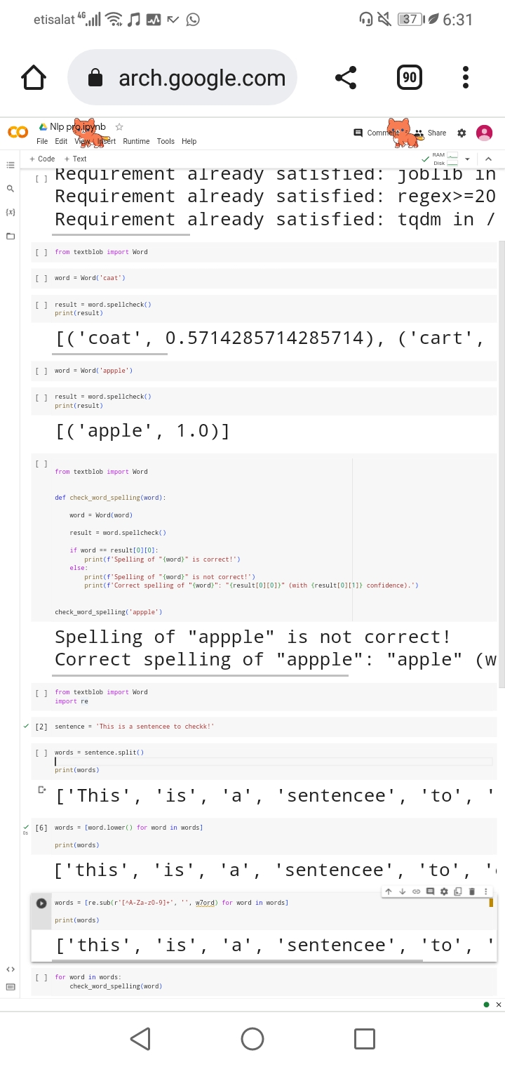
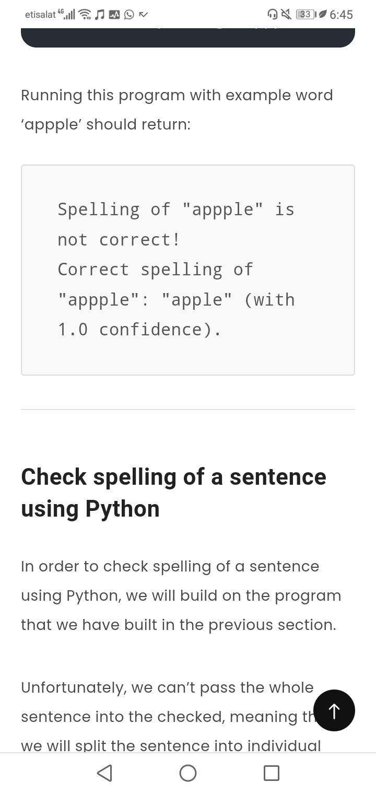
Program to check spelling of a word using Python

Slide 12
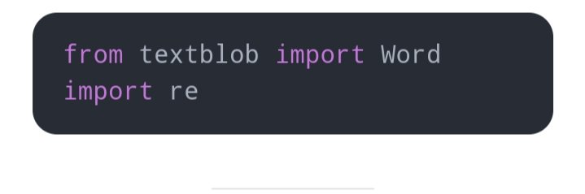
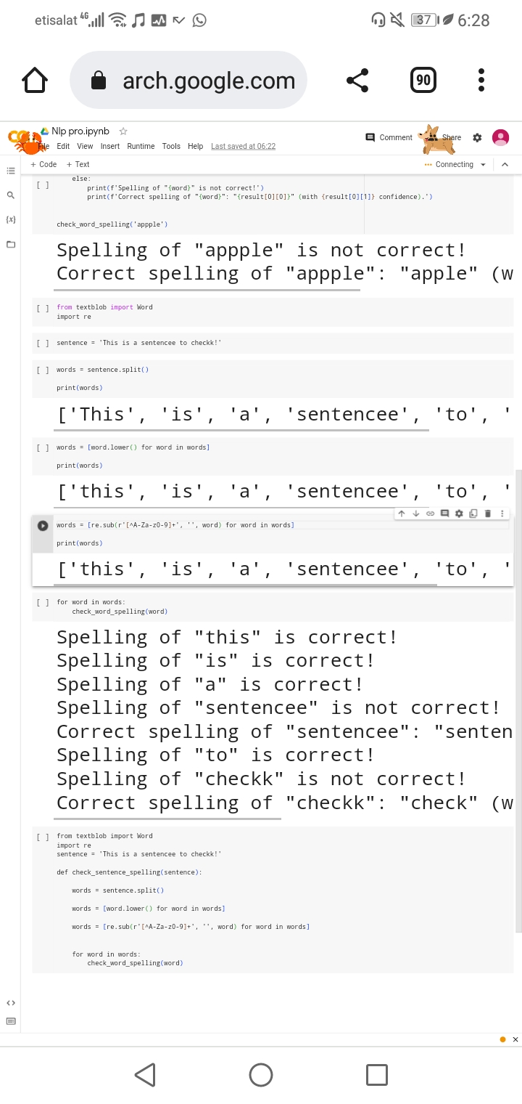
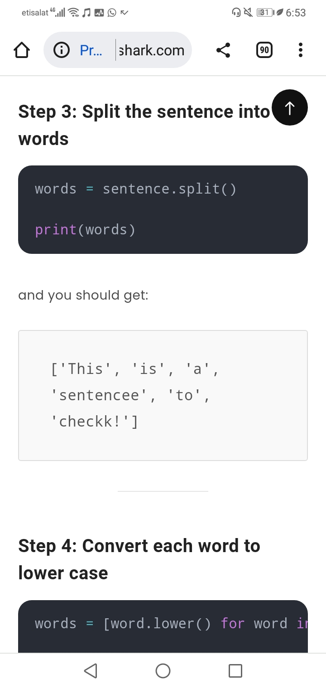
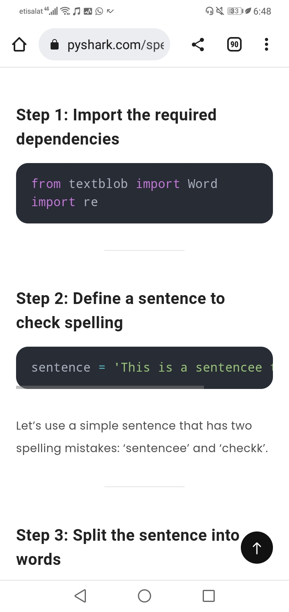
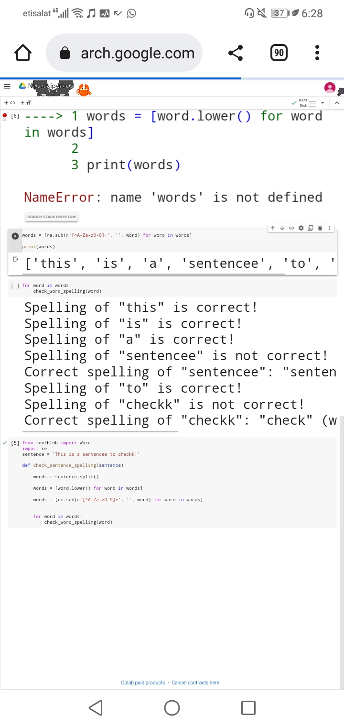
Check spelling of a sentence using Python
Import the required dependencies
Define a sentence to check spelling
Split the sentence into words
Split the sentence into words

Slide 13
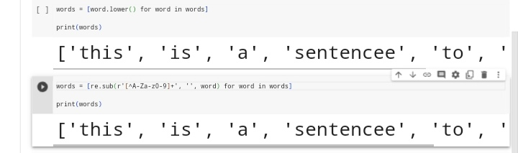
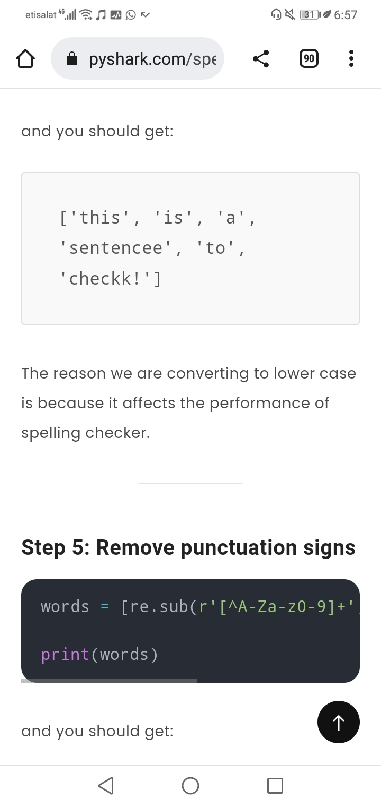
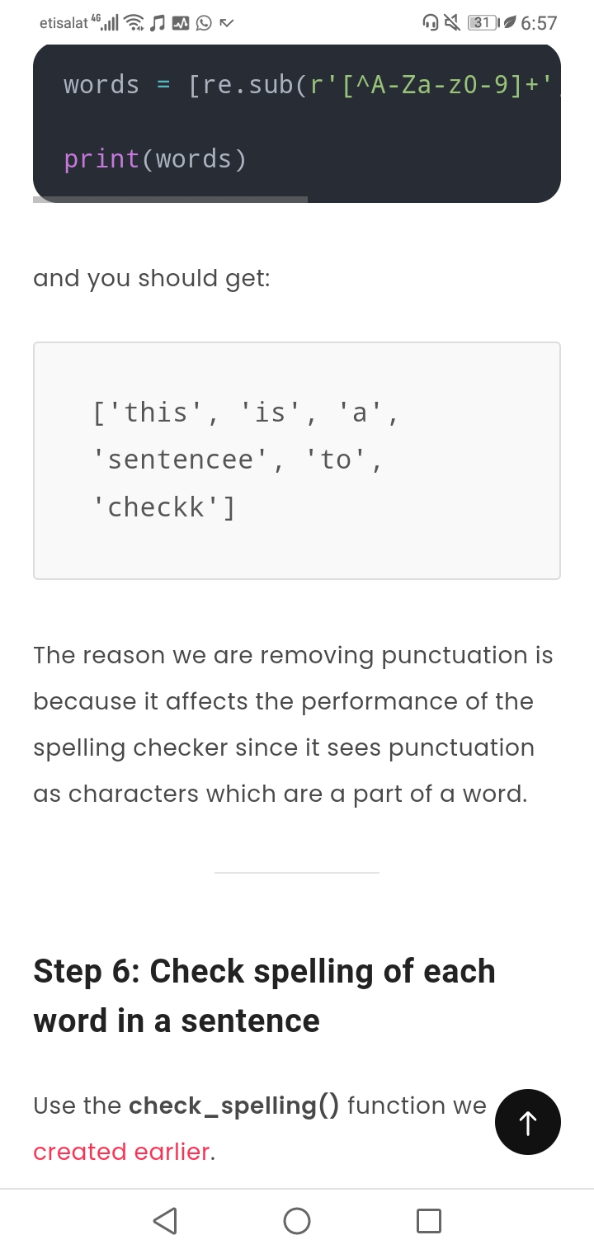
Convert each word to lower case
Remove punctuation signs

Slide 14
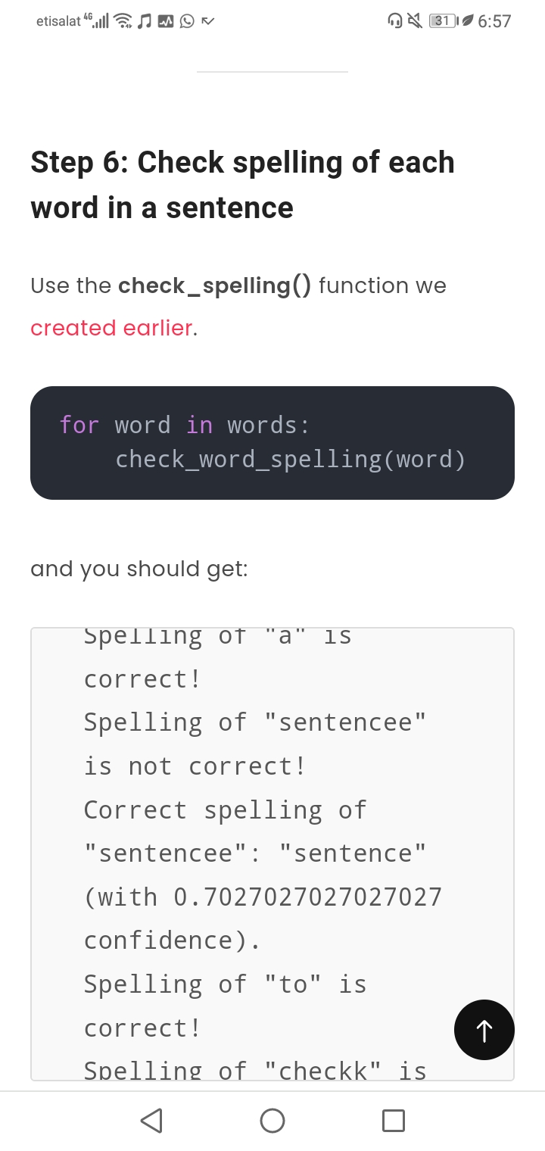
Check spelling of each word in a sentence
Program to check spelling of a sentence using Python

Slide 15
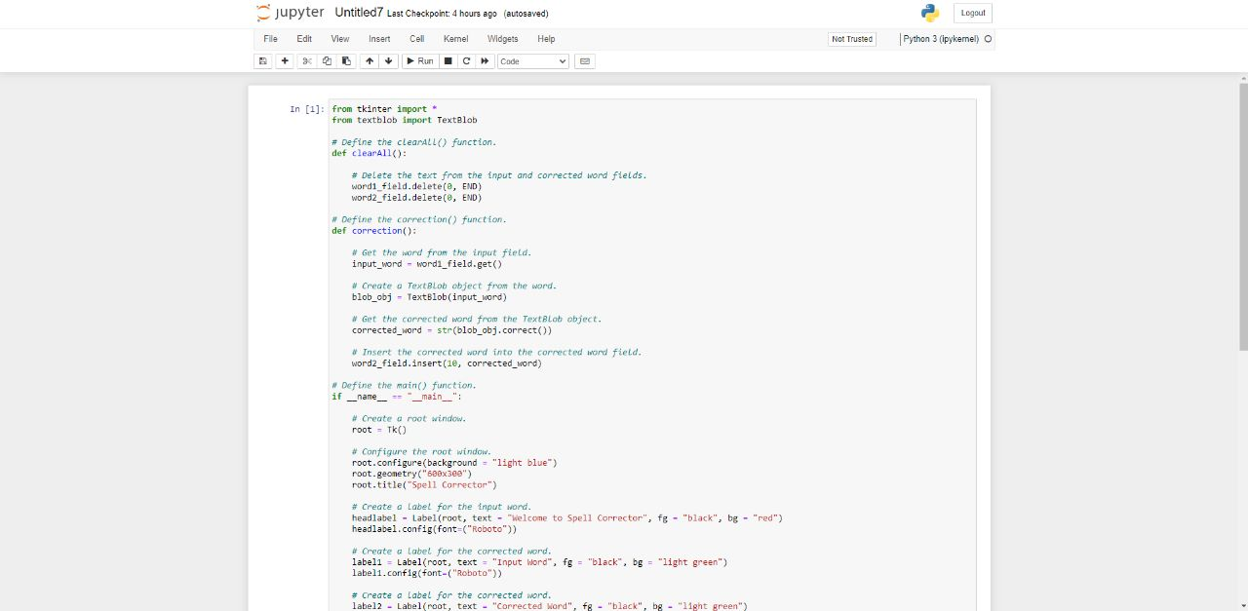

Slide 16
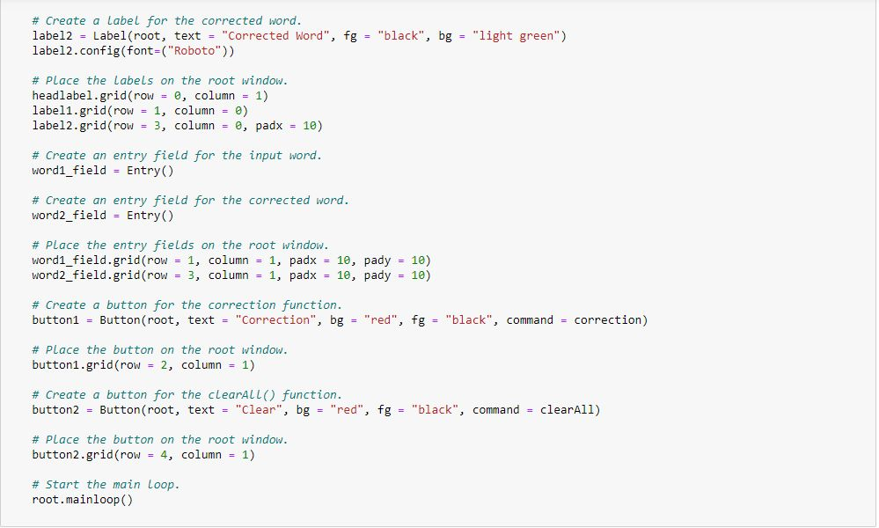

Slide 17
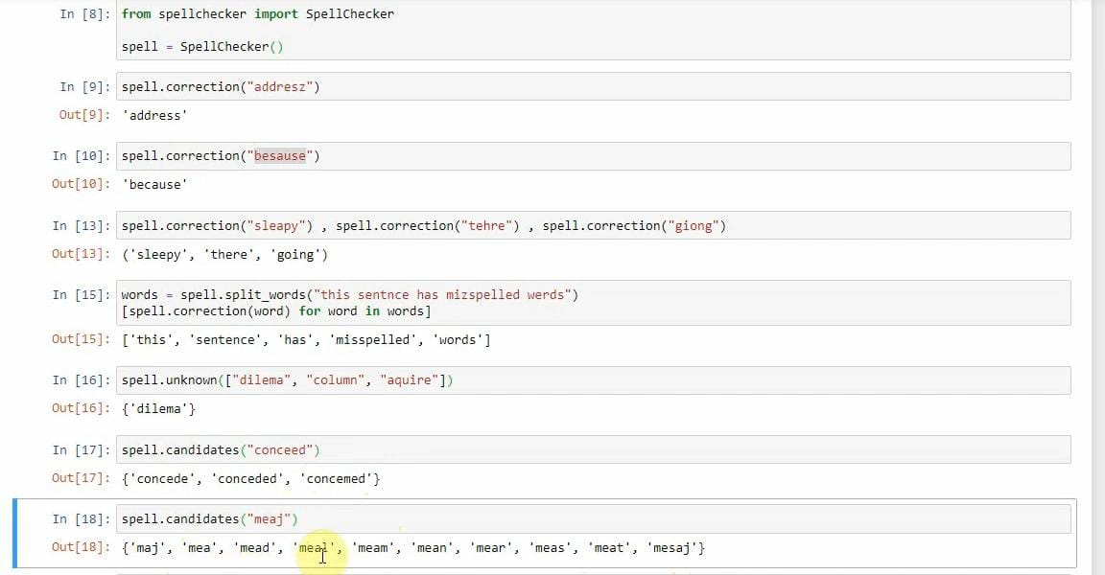

Slide 18
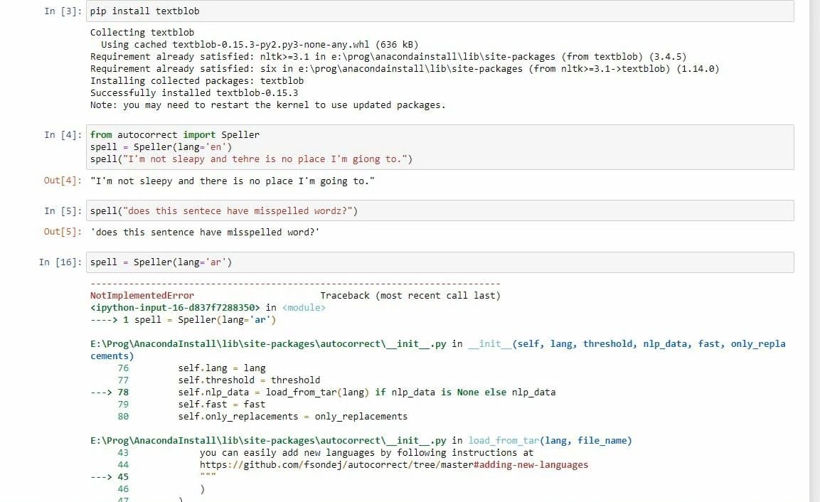

Slide 19
